Slide 1


AI for Autonomous Systems Capstone Project CARTPOLE_V1 - ADVANTAGE Actor Critic
Team:
Hari MM
Shrikrishna Manjrekar
Chellam Sankaran
Guide : Prof. Ambedkar Dukkipati

Slide 2
Abstract
Reinforcement Learning (RL) offers a framework for training agents to interact with their environment and achieve specific goals. However, traditional RL algorithms can be sample inefficient and struggle with stability, particularly in complex environments with high-dimensional state and action spaces. Actor-critic methods aim to bridge the gap between value-based and policy-based approaches, offering a more robust and efficient learning paradigm.
This project implements an Advantage Actor-Critic (A2C) algorithm to solve the CartPole-v1 reinforcement learning environment from OpenAI's Gym. The A2C algorithm leverages both policy and value functions to improve the stability and efficiency of learning. The implementation involves a neural network architecture where the actor predicts the action probabilities while the critic estimates the value function. The agent is trained using a combination of policy gradients and temporal difference methods, allowing it to learn effective strategies for balancing the pole.
The results demonstrate that the A2C algorithm achieves high performance, consistently balancing the pole for extended periods and effectively adapting to the dynamics of the environment. This project highlights the capabilities of actor-critic methods in reinforcement learning tasks.

Slide 3
Problem Statement and Objectives
The CartPole-v1 environment presents a classic reinforcement learning challenge where the objective is to balance a pole on a cart that can move horizontally. The task is inherently difficult due to the need for continuous adjustments to the cart's position based on the pole's angle and angular velocity. Traditional approaches often struggle with instability and inefficiency, especially in environments with high variance in returns. Therefore, there is a need for an effective algorithm that can learn to balance the pole reliably and efficiently, leveraging both policy and value information.
Objectives -
Implement the A2C Algorithm: Develop a robust implementation of the Advantage Actor-Critic algorithm that integrates both policy and value function approximations.
Balance the Pole: Achieve a performance where the agent can maintain the pole's balance for a specified duration (500 times steps) consistently.
Optimize Learning Efficiency: Explore techniques to improve the convergence speed and stability of the learning process, reducing variance in the agent’s performance.
Analyse Performance Metrics: Evaluate the effectiveness of the A2C algorithm through key performance metrics, such as average reward per episode and learning curve over time.
Understand Policy Improvement: Investigate how the agent's policy evolves throughout training and assess the impact of actor-critic updates on learning stability.
Provide Insights and Documentation: Document the implementation process, findings, and challenges faced, contributing to a better understanding of A2C in the context of reinforcement learning tasks.

Slide 4
Key concepts and Overview of algorithm
A2C, or Advantage Actor-Critic, is a reinforcement learning algorithm that combines elements of both policy-based and value-based methods. It is an extension of the actor-critic architecture, with the addition of an advantage function to improve learning efficiency.
Actor-Critic Architecture:
Actor: This component is responsible for selecting actions based on the current policy. It maps states to actions and is essentially the policy function.
Critic: This component evaluates the actions taken by the actor by estimating the value function. It provides feedback on how good or bad the chosen actions are in a given state.
Advantage Function:
The advantage function measures how much better or worse an action is compared to the average action in each state. It helps the algorithm focus on actions that are better than expected and penalize actions that are worse.
Objective Function:
The overall objective function in A2C is a combination of the policy gradient and the value function. The algorithm aims to maximize the expected cumulative reward, which is the sum of the immediate rewards and the estimated future rewards.
Temporal Difference Learning :
A method that updates the value estimates based on the difference between the predicted value and the observed reward plus the estimated value of the next state.
Generalized Advantage Estimation (GAE):
A technique used to compute advantage estimates more efficiently, reducing variance while maintaining bias control.
6. Entropy
It encourages exploration by adding randomness to the policy updates
7. Updating Parameters:
The parameters of both the actor and the critic networks are updated simultaneously. This is done using the gradient of the objective function with respect to the network parameters

Slide 5
Methodology
Stable Baselines3 is a popular library that provides implementations of various RL algorithms in in PyTorch, including A2C. The following steps outline how A2C is implemented using Stable Baselines3:
Environment Setup:
The environment (e.g., CartPole-v1) is created using OpenAI Gym, which provides a standardized interface for reinforcement learning environments.
Model Creation:
The A2C model is initialized with the chosen environment, specifying parameters such as learning rate, number of steps per update,and neural architecture.
Hyperparameter Optimization and Model Training
Optuna objective function is used for hyperparameter tuning, which trains the A2C model and evaluates its performance.
Utilize DynVecEnv for parallel training.
Check for GPU availability and configure the system to use GPU if present and the render mode is set to rgb_array, to capture frames for later visualization
The model is trained on the environment for a specified number of time steps. During training, the actor and critic networks are updated iteratively based on the experiences collected and using best hyperparameters .
Perform hyperparameter optimization with Optuna and get the best hyperparameters.
Evaluation:
After training, the model's performance is evaluated by running it in the environment and measuring the total rewards achieved over multiple episodes.

Slide 6
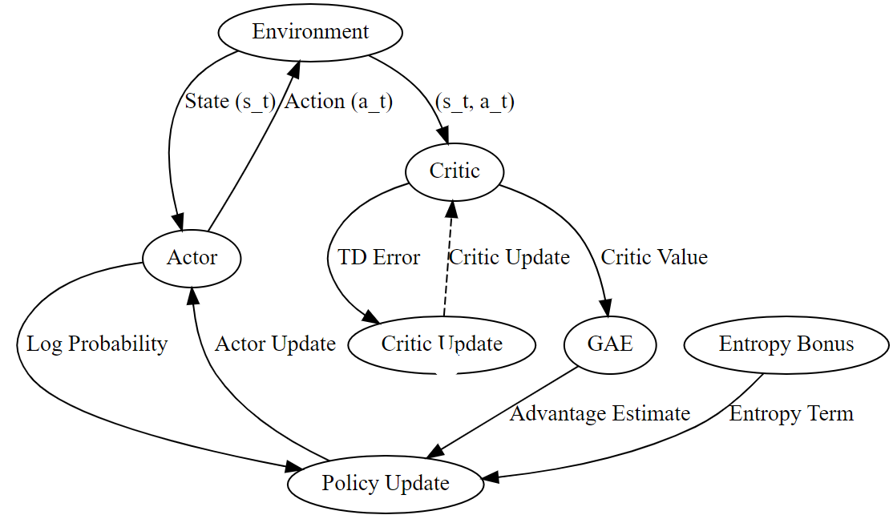
A2C Architecture/Model Details and Data Flow
Environment: The environment interacts with the agent by providing states and rewards. It receives actions from the Actor and sends state-action pairs to the Critic.
Actor: The Actor network decides which action to take based on the current state. It receives the state from the environment and sends the chosen action back. The Actor also receives updates from the Policy Update step to improve its policy.
Critic: The Critic network estimates the value of states or state-action pairs. It receives state-action pairs from the environment and provides value estimates to the Policy Update step. The Critic is updated based on the TD (temporal difference) error.
Policy Update: This step updates the Actor based on the computed advantage function, which measures how good the taken actions are relative to the estimated values. The Policy Update step adjusts the Actor’s policy to maximize rewards.
Critic Update: This step refines the Critic’s value function based on the TD error, which is the difference between the predicted value and the actual reward plus the discounted value of the next state.
Data Flow:
The Environment sends the state to the Actor and receives actions from it.
The Actor provides actions to the Environment and logs the probabilities of those actions.
The Environment provides state-action pairs to the Critic for value estimation. The Critic calculates the TD error and provides value estimates to the GAE and Policy Update steps.
GAE uses the Critic's output to compute the advantage function and sends it to the Policy Update step.
The Policy Update step uses the advantage function, the Actor’s log probabilities, and the entropy bonus to update the Actor.
The Critic is updated based on the TD error received from the Critic Update step.
A2C Algorithm block diagram

Slide 7
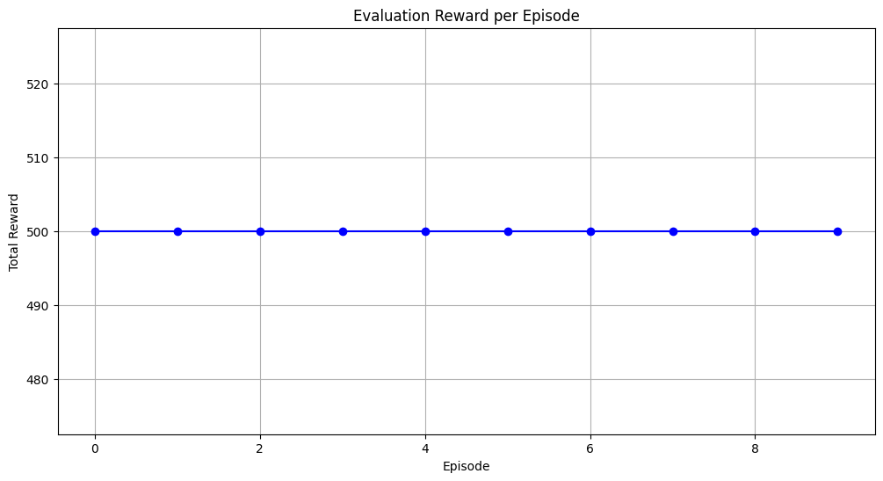
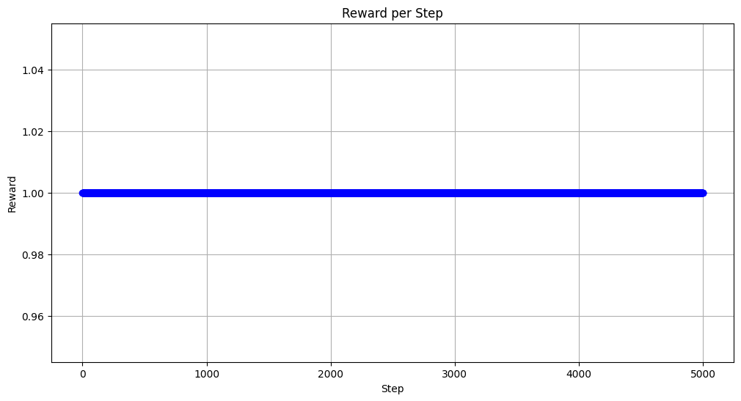
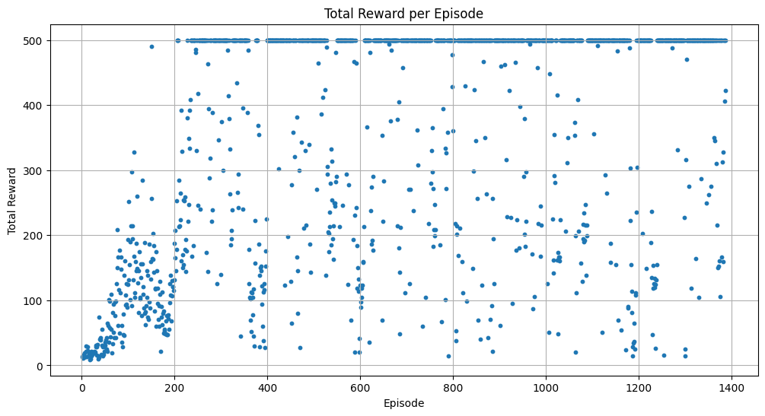
Results and Observations
Plotting for Evaluation Rewards – Rewards per Episode
Plotting for Evaluation Rewards – Rewards per Step
Plotting for Training Rewards
Evaluation Statistics
Total Reward (across all episodes): 5000.0
Total Steps Taken: 5000
Average Reward per Step: 1.00
Average Reward per Episode: 500.00
Total Number of Episodes: 10

Slide 8
Conclusion Summary
The evaluation of the A2C model over 5000 steps, yielded promising results. The model achieved a total reward of 5000.0, indicating a consistent performance across episodes. With a total of 500 steps taken per episode, the average reward per step was calculated to be 1.00, reflecting the model's ability to make effective decisions at each stage of the environment.
Furthermore, the average reward per episode stood at 500.00, suggesting that the model maintained a steady performance level throughout the evaluation. This consistent scoring across episodes indicates that the A2C algorithm has successfully learned to balance the pole effectively.
Overall, the results demonstrate the model's capability to achieve its objectives within the CartPole-v1 environment, showcasing its potential for further applications in more complex reinforcement learning tasks. Future work may involve implementing the steps in other environments and get a good understanding of handling both discrete and continuous space environments

Slide 9


